Slide 1
Devon’s Speech, Language and Communication Needs (SLCN) Strategy for Children and Young People (CYP)
0-25 Years
.
2025-2030

Slide 2
Contents
Introduction .................................................................................................,.....................................................................................................3
Understanding speech, language and communication needs (SLCN)..............................................................................................................5
Strategic Drivers
  Predicted level of SLCN need .................................................................................................................................................................7
  SLCN SEND data and link with neurodivergent conditions ....................................................................................................................9
  SLCN and life chances .........................................................................................................................................................................10
  Challenges ............................................................................................................................................................................................11
  Current offer ..........................................................................................................................................................................................12
  Voice of children/young people, families and staff ................................................................................................................................13
  Evidence base ......................................................................................................................................................................................14
Principles underpinning approaches in Devon ..............................................................................................................................................15
SLCN transformation programme
  The Integrated Care System Strategy and Joint Forward Plan (JFP) ..................................................................................................16
  JFP objectives ......................................................................................................................................................................................17
  SLCN programme aims ........................................................................................................................................................................18
  SLCN programme focus .......................................................................................................................................................................19
  Strategic initiatives ................................................................................................................................................................................20
Measuring and evidencing impact ..................................................................................................................................................................22
Additional support and information .................................................................................................................................................................24
Appendices .....................................................................................................................................................................................................25

Slide 3
Introduction
Why do we need this strategy?
This strategy is the culmination of the thinking of parents, carers, NHS and Social Care as well as Education partners. It brings together learning from experience and professionals, evidence and best practice, policy and wider strategy (including the Inclusion and Learning and SEND Strategies of One Devon Local Authorities) to offer a One Devon view on how together, we can better support children and young people and families with SLCN to achieve their potential and live their best lives.
Who has prepared this strategy and how has it been prepared?
The production of this strategy has been led by NHS Devon, working in partnership across One Devon with experts by experience and profession. NHS Devon has long aspired to a cohesive core strategy to underpin future work. In developing this document, the intention is to ensure a One Devon, shared strategic intent, whilst recognising, through Local Authority aligned implementation plans, a local context for delivering meaningful improvement
What is the national context?
This strategy is developed at a time of significant change in the national landscape and architecture of the NHS and Local Authorities. There are emerging legislative and policy changes, and national long-term plans and priority shifts on the horizon. Across One Devon partners must therefore maintain an ability to adjust and adapt plans to respond.
At a national level a number of issues related to polices and practices for SLCN have been identified including:
Confusion regarding strategic roles and responsibilities, funding and accountability: Multiple agencies are involved in commissioning Speech and Language Therapy services and support which has led to unclear boundaries over who is responsible for what. This has contributed to fragmentated approaches that hinder service delivery and outcomes.
Inconsistent approaches to joint and integrated commissioning: This has led to different structures, commissioning and performance management arrangements being established across the UK.
Lack of shared data and shared outcomes: This has led to inefficiencies related to service provision and practice across system partners and local areas and difficulties evaluating needs and success across sectors.

Slide 4
Differences in funding levels in public sector: This has led to a lack of parity across England and a ‘post code lottery’.
Short term solutions to address factors related to social disadvantage: leading to approaches not being embedded in a sustainable manner.
Differences in terminology between health and education: This has led to differences in terms of how SLCN is conceptualised and understood at a population, cohort and individual level. It is also a contributing factor related to under identification.
Models of working and roles/responsibilities: Historical ways of working including the use of both the deficit and medical models, and a lack of understanding of evolving roles and responsibilities have impeded efficacy of approaches and negatively impacted on the development of transdisciplinary and collaborative approaches.
Wait times and lists: There are currently long waiting lists to access speech and language therapy in many areas. NHS England figures show that in September 2024, 64,604 children were on a waiting list for speech and language therapy – 41% of these (over 26,000) have been waiting more than 18 week.
Recruitment and retention: there are insufficient numbers of speech and language therapists to meet current and future levels of need. This issue is further compounded by the number of therapists leaving the profession or public sector.
Limited and inconsistent engagement with families: This has led to parents and carers not being involved in shaping services, which can reduce the relevance and uptake of support and lead to increased dissatisfaction.
Glen Carter, Head of Scotland Office RCSLT, 2024.
‘It is widely acknowledged that wait lists and wait times are being driven by several factors including limited capacity within the workforce; sufficiency issues as well as historical inconsistent and inequitable ways of working across system partners in relation to addressing barriers to inclusivity practices. All of these factors have led to needs escalating and placing additional pressure on the demand for diagnostic assessments and applications for Education, Health and Care Plans’ Public Accounts Committee, 2025.

Slide 5
Understanding Speech, Language and Communication Needs
What is Speech, Language and Communication Needs?
Whilst most children and young people will develop typical speech, language, and communication skills a substantial proportion will not. Within this strategy Speech, Language and Communication Needs (SLCN) is a term used to describe all children, young people and adults who find it difficult to develop the speech, language, and communication skills they need for life: for socialising, for learning, for well-being and good mental health and to increase opportunities for employment and participation. Speech, language, and communication needs can affect children, young people, and adults of all ages and from all backgrounds. For some, the needs may be mild or transitory whilst in others they are more serious and persistent.
There are many reasons why children and young people may struggle to develop these core skills. There is significant evidence that there is an association between social disadvantage and a child’s ability to develop effective speech, language and communication skills.
Pre-Covid 19 pandemic research found that at least:
50% of children in socially disadvantaged areas were entering the Early Years Foundation Stage with lower levels of speech and language skills than expected
at least 23% of five-year olds eligible for free school meals were not meeting the expected levels in speech, language and communication at the end of Reception, compared to 13% of those not eligible for free school meals.
Since the COVID-19 pandemic these numbers are now expected to be higher in all geographical areas, due to the children and young people missing out on ‘communication rich experiences’. Whilst long-term empirical data relating to this is still being collated initial findings have led to increasing concerns not only for the school readiness of those children entering the Early Years Foundation Stage but also for those children transitioning from primary to secondary school with over 60% of teachers reporting that pupils are behind with the speech, language and communication skills and having significant concerns about their ability to catch up.

Slide 6
Within this strategy SLCN is understood partly as a public health and equalities concern which necessitates us placing an emphasis on planning for areas where we know there is more social disadvantage as part of our prevention and promotion approaches.
In addition, for at least 10% of our population SLCN will be a persistent, lifelong core area of need that significantly impacts on ‘everyday social interactions or educational progress... and is an indicator as poor prognosis’ For this group of our population the term language disorder is often used alongside the term of SLCN.
7.5% of this group will have Developmental Language Disorder.
The remaining 2.5% will have a language disorder and a biomedical condition, including but not limited to Autism, known genetic conditions, acquired brain injury, sensorineural hearing loss and intellectual disability.
Many children and young people with a language disorder will also have co-occurring conditions including, but not limited to, attention, auditory processing, adaptive behaviour, literacy, and dyspraxia.
It is important to note that SLCN is also a need associated with many neurodivergent conditions and this strategy needs to be understood within the context of the neurodiversity strategy.
See Appendix 1.
‘Commissioning should be based on a robust analysis of the needs of the local population in order to ensure the right support is available’. Speech and Language UK (ICAN) and RCSLT, 2018
‘Identification of needs is important because needs, rather than a diagnostic category, should determine resources applied to supporting the child’. Better Communication Research Programme 4
‘Intervention and educational provision should be based NOT on the diagnosis, but on the child’s detailed profile, severity and functioning in their current environment. Therefore, need for intervention and nature of that intervention may change with time even if the core difficulties remain’ Dr S Ebbels (2018)

Slide 7
Strategic Drivers: Level of need in Devon​
Population: The population in Devon is older than the overall population of England and population growth is above average. 19.2% of the population are aged between 0-18 years.
Predicted level of SLCN: In line with national recommendations which states that ‘commissioners need to apply both predictive population-based calculations based on a broad definition of SLCN and analysis of real time profiling data from the SEN system in order to triangulate the need in a given (geographical) area’ a needs assessment was completed by Better Communication CIC© in 2023 using The Balanced System® Framework.
Using a propriety formula by Better Communication CIC that considers the prevalence rates of language disorders, and the risk factors associated with social disadvantage the predicted level of SLCN as a number and percentage of the population is high across Devon ICS.
It is imperative that this data, which is also available at a district, ward and locality level, is understood and used strategically to plan and deliver services and support. This will enable partners to plan for areas proactively and equitably and adjust the offer accordingly where there is higher level of predicted need.
Area | 0-4 years | 5-9 years | 10-14 years | 15-18 years | 0-18 total | 19-24 years
Devon ICS | 54200 | 63000 | 67700 | 52300 | 237300 | 89800
Proportion of total population (all ages) | 4.4% | 5.1% | 5.5% | 4.2% | 19.2% | 7.3%
 | 0-4 years | 5-9 years | 10-14 years | 15-18 years | 0-18 | 19-24 years
Devon ICS population | 54200 | 63000 | 67700 | 52300 | 237300 | 89800
Devon ICS prediction of SLCN (as % of population) | 17390 (32.1%) | 20212 (32.1%) | 14214 (21%) | 8103 (15.5%) | 59919 (25.3%) | 4496 (5%)
‘We need to be able to estimate potential need in an anticipatory manner so as to enhance support for families and young people based on predicted need and not merely in response to presenting demand’ M Gascoigne, 2025

Slide 8
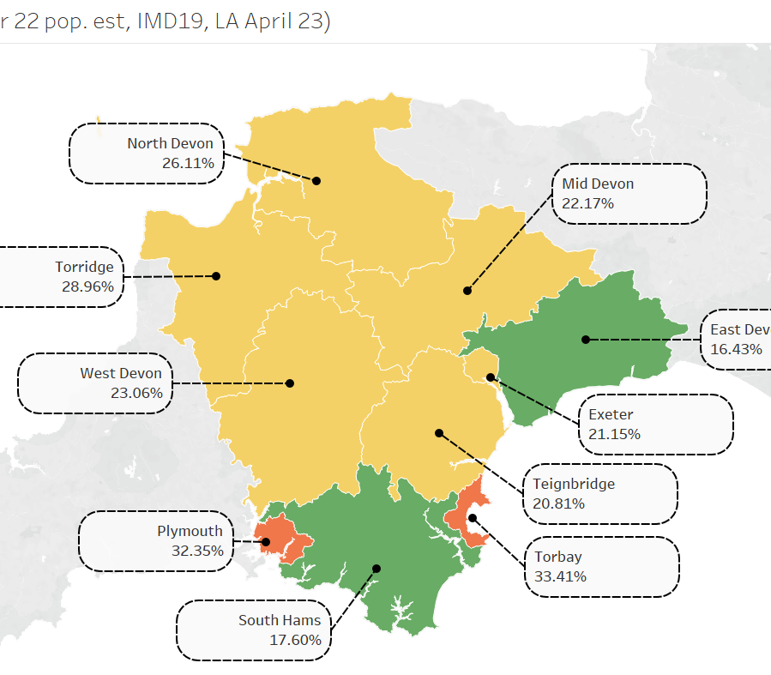
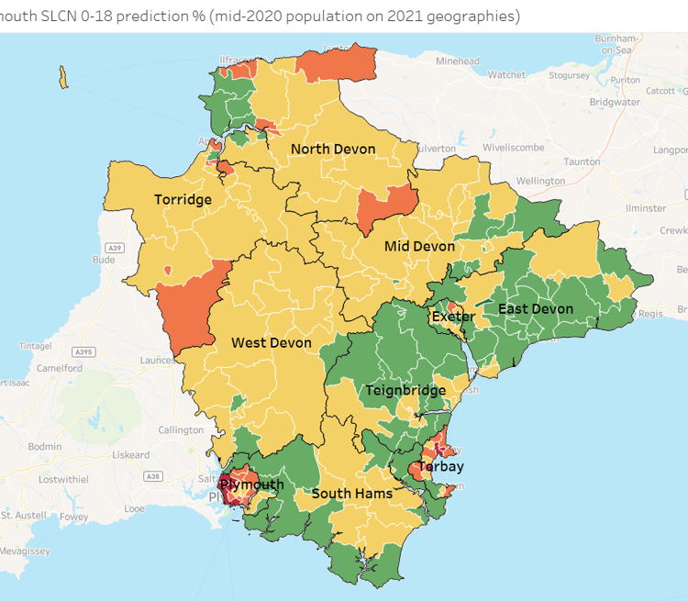
Figures 1 and 2: Predicted level of SLCN across Devon ICS as a percentage of the population- propriety formula devised by Better Communication CIC© on the Balanced System® Framework. This data is available at a more granular level.

Slide 9
SLCN and Special Educational Needs: Across Devon ICS SLCN is the highest primary area of need identified. However, it is important to note that the descriptor used by DfE within the SEND Code of Practice and therefore the figures below do not reflect the breadth of the level of needs as they do not consider the children and young people who have SLCN in addition to other areas of need.
Data taken from The Balanced System Framework and sourced from Special Educational Needs in England, Academic year 2023/24.
SLCN and Neurodivergent conditions: SLCN is a need associated with many neurodivergent conditions. Nationally and locally, this has raised both opportunities and challenges for speech and language therapy teams in terms of reviewing and considering the efficacy of using diagnostic labels and historical core deficit models to structure pathways whilst moving towards a model epitomised by the neurodiversity paradigm to structure and inform provision and practice across a variety of settings and contexts
See appendix 1.
SLCN AS PRIMARY AREA OF NEED | Total 0-18 (EHCP & SEN Support) | Total 0-25 (EHCP & SEN Support) | 0 - 4 years | 5 - 9 years | 10 - 14 years | 15 - 18 years | 19 - 25 years
ENGLAND | 369,897 | 369,941 | 62,918 | 201,174 | 90,213 | 15,592 | 44
DEVON | 5,830 | 5,830 | 638 | 2,948 | 1,924 | 320 | 0
PLYMOUTH | 1,909 | 1,909 | 303 | 1,062 | 452 | 92 | 0
TORBAY | 998 | 998 | 113 | 542 | 297 | 46 | 0
‘The terminology used to identify children's problems has been variable and confusing...however, terminology clarification can potentially help with planning services, data collection and outcome measurements’ RCSLT, 2020.

Slide 10
Strategic Drivers: SLCN and life chances
Children and young people with SLCN face complex challenges and are at increased risk of poor life outcomes, including, academic failure, child exploitation, drug and gang culture, social isolation and poor mental health. Research has shown that children and young people with SLCN are overrepresented in vulnerable cohorts including; Children In Care, Youth Justice Services, Pupil Referral Units and those known to Mental Health Services (see appendix 2). This strategy, therefore, cuts across a number of strategic drivers including Early Help, Family Hub, Best Start in Life, Social Care, Inclusion and Learning as well as SEND.
Social, emotional mental health
81% of children and young people with SEMH have significant unidentified language disorders that impact on their ability to engage with interventions and support (Hollo et al, 2014).
Learning
Employment
Offending
Over 60% of young people who are accessing youth justice services have unmet and unrecognised SLCN (Bryan et al, 2015).
Children who struggle with language at 5yrs are six times less likely to reach the expected standard in English at age 11yrs than children who have had good language skills at 5yrs, and ten times less likely to achieve the expected level in maths (Roulestone et al, 2011)
Children with poor vocabulary at age 5yrs are more than twice as likely to be unemployed at age 34yrs as children with good vocabulary(Feinstein et al, 2006)
There is a clear correlation between many of the groups of pupils who are disproportionately more likely to be excluded, and the groups of children and young people who are more likely to have communication needs (Clegg, 2004; Clegg et al, 2009).
Children with a history of SLCN are 2.7 times more likely to have a social phobia by age 19 (Law et al, 2015).
88% of long-term unemployed young men have been found to have SLCN (Elliot, 2011)
In 2019-2020 the Youth Justice Board found that 71% of children sentenced had speech, language and communication needs (Youth Justice Board/Ministry of Justice, 2021)
“Children with language disorders often lack verbal strategies to manage in the classroom and may only take in one or two words of what is said to them. This can lead to failure following instructions which can be perceived as ‘naughty’ behaviour by the class teacher. Similarly, children with language disorder have difficulty following playground rules, and often misinterpret jokes from peers as other children ‘making fun’. The frustration and inability to respond leads to more disruptive behaviour and increased risk for social, emotional and mental health problems in the longer term.”
Professor Courtenay Norbury, Professor of Developmental Language and Communication Disorders at University College London

Slide 11
Strategic drivers : Challenges
Lack of clarity regarding the wider SLC/SLCN offer:
Increase in demand:
Wait times:
Workforce capacity:
SLT wait times and wait lists increased due to Covid-19 lockdowns and services being paused/stepped down. This has created significant pressures and a backlog of demand.
SLT workforce capacity, particularly in Torbay and Devon, is not sufficient to meet predicted levels of need.
The levels of need and demand across Devon has been exacerbated by the Covid-19 pandemic. This has led to many services, particularly speech and language therapy, experiencing an exponential growth in referrals.
Approaches related to early identification, intervention, prevention, and promotion are not fully known and understood across system partners and providers and therefore were not being fully utilised or realised as an integrated system wide offer.
Wait list recovery work has challenged capacity to implement transformational approaches.

Slide 12
Strategic Drivers: Current Offer In Devon
Across Devon the majority of children and young people’s community services, including speech and language therapy, are commissioned by NHS Devon and delivered by:
Livewell Southwest (LSW)
Children Family Health Devon (CFHD)
VRANCH House
However, in line with national findings within Devon there is an array of wider commissioning arrangements for speech and language therapy including NHS England, local authorities, settings, schools and colleges as well as parents and carers. There is substantial evidence at both a national and local level that these diverse arrangements and a lack of a common framework has led to increased siloed working, differences in approaches, inequity, children/young people ‘falling through the gaps’ of different providers and a lack of understanding of the offer as a whole.
Legislation such as the Children and Families Act 2014 and the SEND Code of Practice expects local areas to develop joint commissioning arrangements. This involves bringing together the different organisations to review their current approach to commissioning for SLCN to maximise the use of finite resources and improve outcomes for 0-25 year olds, including those with SEND and their families.
This strategy recognises that SLTs provide only part of the offer to children and young people. Education, care, public health, voluntary, community and the independent sector also contribute to the SLC and SLCN provision in a multifaceted manner. Evidence has shown that mapping and understanding this wider offer enables a clearer overview of the different elements and how they contribute to the whole picture. This in turn enables greater opportunities for effective integration, improvements in service design as well as enhancing opportunities for efficiencies to be identified and addressed in a sustainable and responsive manner. This ensures there is an equitable and robust continuum of offer that meets needs in a holistic manner.
‘It is important for commissioners to consider the whole range of provision, the need for complementary system components and how the parts work together. There needs to be an understanding of services provided by the local authority, schools, health agencies, the voluntary and community sector, and private or independent providers’ Commissioning Support Programme, 2011

Slide 13
Strategic Drivers: Voice of Children, Young People, Parent/Carers & Staff
Parents and Carers tell us…
communication about waiting times and what happens during and after an assessment were important information for them.
Staff tell us...
due to statutory pressures place based approaches that facilitate collaborative working are inconsistent
Children & Young People tell us…
they want support and help which is easy to navigate and is comprehensive that meets their needs
they want the adults around them to know and understand their needs, to be able to support them with appropriate strategies so they can achieve their goals, participate and be included
functional outcomes from assessments and the support required to meet these are not always clear
there is a lack of clarity regarding how teams across the system interface with each other, their contribution to the offer and their active involvement in the Assess, Plan, Do and Review process
there is a need for better, more regular communication and the chance to talk to someone about their concerns, their child’s needs, the impact these needs are having at a functional level and the support that is required to meet the need
wait lists, poor experience, sustained pressure, and limited ability to recruit to vacancies adversely impact motivation and retention of workforce
they are frustrated with the long waiting times for support which negatively impacts their education, mental health, and overall well-being
lack of training, time and capacity can result in increased referrals
they want clarity on how to get advice, what support is available and how to access it
sharing of information across organisations is hard to coordinate and track. Often information relating to SLCN is not shared at transition points leading to a lack of continuity
too often they have to repeat their story to multiple professionals
they don’t feel confident that their children’s SLCN are being recognised, understood and met
service specifications and contract monitoring tend to focus on inputs and outputs rather than impact
too often competing priorities mean that SLCN is not prioritised
there is a need for better support in schools and settings where they spend their time
they feel like they are jumping through hoops to access support
Notes:
Removed EP reference

Slide 14
Strategic Drivers: Evidence Base
Safe:
Effective:
Equity:
Efficient:
Experience:
Families feel pathways are confusing and siloed, with little access to help whilst waiting, people then go on to feel abandoned by services after assessment or diagnosis.
When children and young people get timely access to the inclusive services they need (with or without diagnosis), it can make a huge difference to their happiness, wellbeing and development.
Understanding the needs of a child/young person improves practitioners ability to adapt approaches. This increases the potential of the CYP to engage in interventions and achieve their potential.
The most disadvantaged children are disproportionately impacted by delayed access to support, primarily because families with means can choose to pay to access private assessments and support.
Long waits are a source of poor experience, identified in complaints and concerns raised with the ICB and providers.
Delays in support results in poor life chances and outcomes (see appendix 2).
A lack of timely and effective support can result in increased pressures and costs within special educational provision and specialist services
CYPs with SLCN, who do not receive timely and effective support are at increased risk of experiencing higher unemployment. This has been found to have a direct correlation to the ‘cost to the nation’.
Notes:
See reference section
We must address the long waiting times that children face in community health and mental health settings, including children with neurodevelopmental conditions. the government must invest in increasing the number of available appointments
There must be additional focus on what is required to effectively support children and young people so that a diagnosis is not one of the only ways to unlock support in school, health services, social care, and the community.
The Action Plan must include a joint health, education and social care workforce strategy for disabled children, children with special educational needs, and neurodivergent children. Schools should be equipped to provide all the core services that children need to thrive.

Slide 15










Strategic principles that underpin our approaches across Devon
Child and family centred
Needs-led rather than service-led
Consider the whole person
    Child centred
Experience of families
Families are respected, heard, considered and believed
Sharing your experience makes a difference
Meet us where we are
Make things easier, not harder
Children, young people and families as true partners
We can work together
    Work with us
Inclusive communities
Communities understood and meet our needs
Misconceptions are challenged and corrected
We are not excluded
The right support at the right time.It shouldn’t matter where you live or who you are
People around you who understand
    Early support
Recognise needs
More people should know and be confident about neurodiversity
Look beyond behaviour
Take aware hoops to jump through
Seeing the whole, real person
Recognising strengths
Open up hope
Not just good enough
    Aspiration
Long term thinking
Most neurodiversity is lifelong
Planning for next steps
Impact and value rather than short term cost
This should start early – transitions are stepping stones
Individual approach
Celebrating achievements
Consider independence
    Independence
Communication
Keep in touch
Give us the right information
Treat us with respect
Devon Parent Carer Neurodiversity Expert Reference Group, 2024 (see Glossary)
Notes:
Preferred

Slide 16
The Integrated Care Strategy and One Devon’s Joint Forward Plan (JFP)
ICS strategy vision
Equal chances for everyone in Devon to lead long, happy, and healthy lives
ICS strategy ambition
All children and young people to have the best start in life, grow up in loving and supportive families, and be happy, healthy, and safe
JFP SLCN transformation programme vision
Children and families with neurodiverse, emotional and communication needs will be able to access effective, timely and appropriate support across health, care and education, preventing crisis and enabling them to live their best life

Slide 17
Strategic Objectives within the JFP
Inclusive Communities: children and young people will be able flourish and live their best life in neuro-inclusive and communication friendly and affirming cultures, environments & communities.
Needs identified and supported earlier: Children and young people and their families will get the help they need sooner because we will work to identify and respond to individual’s needs sooner and offer support that works for them, when they need it.
Integrated support and services: Children and young people and their families will get the help they need sooner because of better integration, communication and efficiency resulting in a greater effectiveness of the services across One Devon.

Slide 18
SLCN transformation programme strategic aims:
Prevention: Devise and implement an evidenced base, transformational programme of work that has a preventative approach at the core.
1
Integrated working: Drive a shift in practice from siloed approaches to one of collaboration with an emphasis on effective family support, enabling environments, workforce development, early identification, effective intervention, and support to reduce the risk factors and increase the protective factors in a child and young person’s life.
2
Sustainable delivery: Work collaboratively to identify ways to increase Speech and Language Therapists capacity to deliver the professional leadership needed for training and support (universal, targeted and specialist) across the wider workforce and other stakeholders.
3

Slide 19
Strategic focus: To implement an evidenced based framework and sustainable delivery model to drive forward improvements
This strategy
recognises that Speech, language and communication is ‘Everyone’s Business’ ; it does not fall to one single agency to meet the need - a whole systems approach is required. We are required ‘to think differently ’ and for us to be ambitious at both an organisational and strategic system level to improve transdisciplinary approaches in the context of where the child/young person and their families are.
seeks to implement a holistic, population and evidenced based approach to SLCN to support our ability to aid recovery, develop sustainable approaches and improve outcomes for all our children and young people. To achieve this, consideration needs to be given as to how ‘services are planned, delivered and accessed ’ so together we can improve commissioning, practice and provision in both the short and long term.
recognises that to address the scale of SLCN across Devon, there needs to be a shift in focus with a move from the approach of routinely referring all children to an “expert”; to an approach which develops and facilitates expertise within the context in which the child lives. Most importantly this includes supporting parents and those closest to the child to develop the skills needed to support their child’s SLC/SLCN.
To structure this work the SLCN strategy is using The Balanced System® Framework as a delivery model to drive forward improvements and facilitate transformation across health, education and care.
The Balanced System® is an established, population-based, needs led and outcomes focused approach that provides a whole system framework to improve the commissioning and delivery of services and support for SLCN in an integrated manner. Co-produced outcomes for children and young people and shared responsibility and accountability across the system partners for delivering these is a fundamental aspect of this framework.
In this model of support, speech and language therapy and support is delivered through collaborative working, supporting the child within the context of the home, early years and educational settings, and the wider community by working in partnership with others.
Research has shown that successful implementation of The Balanced System® Framework ensures that children and young people with speech, language, and communication needs get the right support at the right time, in the right place from people with the right skills; helping them achieve the outcomes that matter to them.

Slide 20
SLCN programme strategic Initiatives: The implementation of this strategy and system wide transformation is built on the 5 core principles of The Balanced System® Framework
Easy Access:
Parents and carers will receive support and advice in a timely and accessible manner and be practically involved throughout their contact with services.
Early identification of need will be strengthened through a needs-led, primary-prevention offer as well as an enquiry-based assessment approach
Processes and systems in place for sharing information and data within and across organisations and teams will be as efficient and accessible as possible.
Functional Outcomes:
Improved use of data, including functional impact measures and evidence, will inform commissioning, joint planning and delivery of outcomes and support, enable sufficient workforce capacity and inform allocation of resources
High Quality Information, signposting and resources:
The SLC and SLCN offer will be accessible and promoted through range of media including online.
Place Based Approaches:
Developing and implementing accessible and place-based SLT within Family Hubs, Schools and Settings to enable others to effectively support children, young people & their families
Practitioners will be able to identify need at the earliest opportunity and provide effective support to children/young people
A seamless integrated offer of intervention and support will be provided at the earliest opportunity, as soon as needs arise, and in the most appropriate environment
Robust Continuum Of Offer including an impactful targeted offer
Speech and Language Therapy (SLT) offer will be clear within the wider system SLC/SLCN offer of provision for all children and young people (0-25yrs)
There will be a strong, comprehensive universal and targeted offer across all 5 strands of the Balanced System® Framework
Resource will be allocated accordingly and proportionately in areas of higher need – either or both the nature of the offer or the volume of the offer
.

Slide 21
Drawing it all together to create a powerful and purposeful strategy
Vision & Purpose
Children and families with neurodiverse, emotional and communication needs will be able to access effective, timely and appropriate support across health, care and education, preventing crisis and enabling them to live their best life
.
Strategic Objective 1:
Inclusive Communities
Strategic Objective 2:
Identify & Support Needs Early
Strategic Objective 3:
Integrated Services
Strategic Initiative 1
Functional outcomes
Strategic Initiative 2
Place Based Approaches
Strategic Initiative 3
Easy Access
Strategic Initiative 4
Robust Continuum of Offer
Strategic Initiative 5
High Quality Information
Enablers: Co-Production, Workforce, People & Culture, Finance
Principle 1
Child Centred
Principle 2
Work With Us
Principle 3
Recognise Needs
Principle 4
Early Support
Principle 5
Aspiration
Principle 6
Communication
Principle 7
Inclusive Communities
Principle 8
Experience of Families
Principle 9
Long Term Thinking
Principle 10
Independence
Foundational Elements: Alignment of Strategy, Vision and Effort
Evaluation: QI & Cultural- Four Cornerstones
(across different programmes and organisations)

Slide 22
Measuring Impact:
Improved outcomes and experiences of services for CYP and their families
Downward projection of referrals being made to SLT due to increased needs being met more effectively at a targeted level
There will be shorter waits lists and times for SLT support
Reduction in number of fixed term or permanent exclusions
CYP and their families experience improved integrated support and report they have confidence in the system and offer.
There will be a systematic approach to meeting needs and this is reflected in how plans are developed and prioritised so that improvements are meaningful for CYP and their families across Devon.
There will be sufficient SLT workforce to meet predicted level of need- improved staff retention and recruitment

Slide 23
Evaluating Impact:
The One Devon SLCN Strategy incorporates aspects of cultural change and quality improvement. Implementation plans will include a description of the intended impact, and the metrics and measures used to understand delivery, however, wider evaluation will bring together oversight of evaluation. To understand the impact of the strategy the evaluation approach must consider understanding and evaluation of culture change (aligned to the Four Cornerstones) and, more traditional quality improvement approaches, as set out below:
Domains of Four Cornerstones Evaluation Methodology
Domains of Quality Improvement Evaluation Methodology
Welcome & Care
Value & Include
Communicate
Work in Partnership
Efficient
Effectiveness
Equitable
Experience
Overall Approach: Collaborative and broad qualitative insight driven approaches which track cultural and experiential shifts aligned to the four cornerstones. Iteratively and collaboratively developed.
Measures: Qualitative and experiential factors
Mechanism: Collaboration to be defined.​
Overall Approach: Many small, measurable changes: Evaluation of pilots/ projects to deliver a ‘mosaic’ of changes and measures.
Refining improvements through use of iterative approaches (continuous PDSA cycles) to promote continuous improvement. ​Include an Adopt, Adapt, Abandon reflection space to critically evaluate and collaboratively agree next steps.
Measures: Qualitative and quantitative spanning experience, performance and efficiency align to healthcare quality domains
Mechanism: Collaboration through evaluation and research partnership.​

Slide 24






Additional Support and Information about Services
(click on the icon to link to website)
One Devon is a collaboration of the NHS and local councils, as well as a wide range of other organisations like the voluntary sector, who are working together to improve the lives of people in Devon.
We want to make our system as strong and effective as possible, through partnership working and with the ambition to tackle health inequalities, help communities thrive and achieve the very best for everyone.
My Health Devon is part of the emergent Integrated Care Service ‘Together for Devon’ health and care working in partnership with local communities in Plymouth, Torbay and the rest of the County.
The Parent/Carer forums work in partnership with services provided by education, health and care with an aim to ensure that the needs of children with SEND and their families are being met effectively.
Notes:
Add nice guidance links

Slide 25
Appendices
2. SLCN and life chances
5. Recommendations from the Children’s Commissioner’s Report (Oct 2024)
6. References
7. Glossary
1. Scope of this strategy
3. Principles- the way we work
4. Programme Outcomes and Objectives

Slide 26
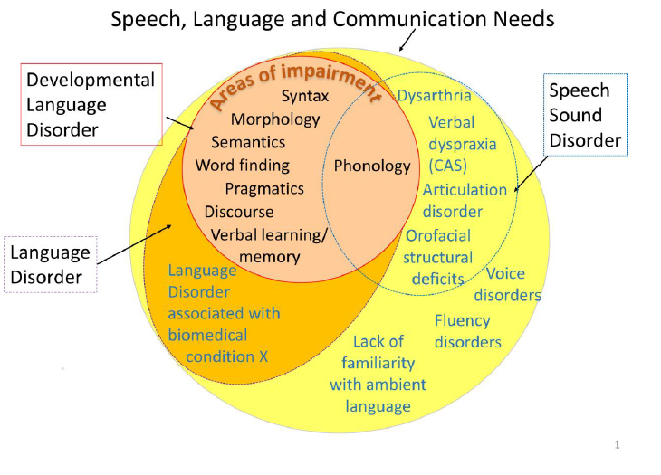
Appendix 1: Scope of this strategy
Within this strategy Speech, Language and Communication Needs (SLCN) is understood as a ‘broad category which includes all children with Language Disorder and Developmental Language Disorder (see next slide), but also includes all other children who have difficulties with speech, language or communication for any reason’ CATALISE: a multinational and multidisciplinary Delphi consensus study of problems with language development. Phase 2 Bishop, D. V. M., Snowling, M. J., Thompson, P. A., Greenhalgh, T., & The CATALISE Consortium Summary by Susan Ebbels – revised 13th February 2017 .
Consequently, this strategy can be applied to any child or young person who has difficulties with speech, language and communication, with or without a diagnosis.
Bishop, D. V. M., Snowling, M. J., Thompson, P. A., Greenhalgh, T., & Catalise-consortium. (2017). Phase 2 of CATALISE: a multinational and multidisciplinary Delphi consensus study of problems with language development: Terminology. Journal of Child Psychology and Psychiatry.. doi:10.1111/jcpp.12721. http://onlinelibrary.wiley.com/doi/10.1111/jcpp.12721/full

Slide 27
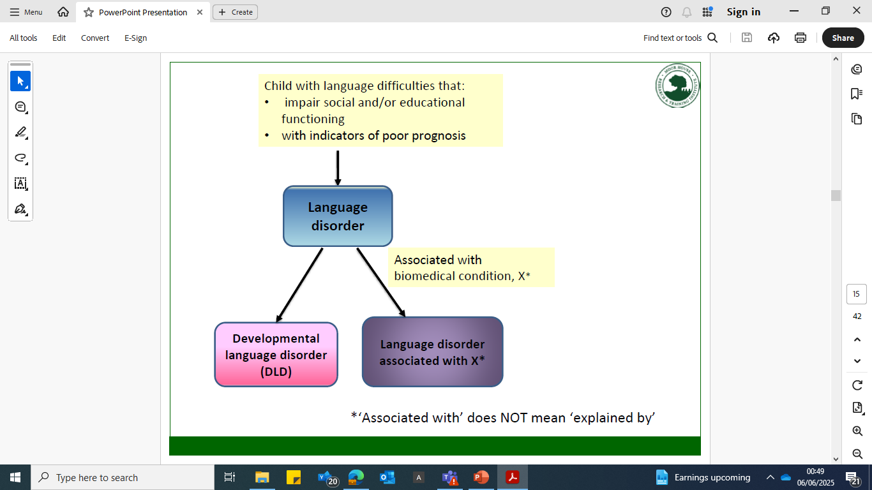
Indicators of poor prognosis include:
poor language comprehension
several areas of language affected
poor use of gesture
family history of language impairment, and/or
poor response to intervention
Language Disorder can be associated with (in addition to) a biomedical condition such as: brain injury; acquired epileptic aphasia in childhood, neurogenerative conditions, genetic conditions, cerebral palsy, sensori-neural hearing loss, autism spectrum disorder, intellectual disability.
If a biomedical condition is not present then a diagnosis of Developmental Language Disorder (DLD) can be given.
DLD can co-occur with other neurodevelopmental disorders. These include difficulties in the areas of:
Attention (e.g., ADHD)
Motor (e.g., dyspraxia, dysarthria)
Literacy
Speech
Executive function
Adaptive behaviour
Behaviour problems
Auditory processing (e.g., APD)
Low-normal range nonverbal ability
Environmental and biological risk factors that are associated with an increased likelihood of language problems include:
family history
male
poverty
low level parental education
neglect or abuse
problems around or before time of birth

Slide 28
Appendix 2: SLCN and life chances
81% of children and young people with SEMH have significant unidentified language disorders that impact on their ability to engage with interventions and support (Hollo et al, 2014).
Anxiety is higher in individual with Developmental Language Disorder (DLD) than age matched peers and remains so from adolescence to adulthood (Botting et al, 2016).
Children with a history of SLCN are 2.7 times more likely to have a social phobia by age 19 (Law et al, 2015).
Children with poor vocabulary skills are twice as likely to be unemployed when they grow up (Law et al, 2009)
Between 60-90% of young people who are accessing youth justice services have unmet and unrecognised SLCN (Bryan et al, 2015).
Over 60% of Children In Care have unmet and unrecognised SLCN (Office for National Statistics)
58% of the young people screened by SLTs as part of No Wrong Door, model around rethinking care for adolescents, were identified as having SLCN
90% of children and young people referred to a pupil referral unit were found to have unmet and unrecognised moderate to significant SLCN (London Borough of Newham)
Children who struggle with language at 5yrs are six times less likely to reach the expected standard in English at age 11yrs than children who have had good language skills at 5yrs, and ten times less likely to achieve the expected level in maths (Roulestone et al, 2011)
Children with poor vocabulary at age 5yrs are more than twice as likely to be unemployed at age 34yrs as children with good vocabulary (Feinstein et al, 2006).
There is a clear correlation between many of the groups of pupils who are disproportionately more likely to be excluded, and the groups of children and young people who are more likely to have communication needs (Clegg, 2004; Clegg et al, 2009).
Those who are subject to child protection orders because of suspected or confirmed maltreatment face an elevated risk for SLCN (Sylvestre et al, 2015)
One study followed up 5yr olds with language disorder to adulthood and found them to be nearly three times more likely to report child sexual abuse than their peers (Sullivan et al, 2000).
88% of long-term unemployed young men have been found to have SLCN (Elliot, 2011)
EDUCATION
CHILDREN IN CARE
SEMH
EMPLOYMENT
YOUTH JUSTICE
SOCIAL MOBILITY
Pre-covid 19 50% of children in socially disadvantaged areas were entering the Early Years Foundation Stage with lower levels of speech and language skills than expected
SAFEGUARDING
Poverty can strongly reduce parents’ ability to respond to their child’s early language needs and offer a home learning environment that enhances language skills in the early years
HOMELESSNESS
People experiencing homelessness are 17% more likely to have SLCN. These needs often present barriers to accessing support (RCSLT, 2024)
Children with language difficulties have a worse quality of life in terms of moods and emotions and are more at risk in terms of social acceptance and bullying (Lindsay and Dockrell, 2012)
Children’s vocabulary and ability to talk in two-to-three-word sentences at the age of two is a strong predictor of ‘school readiness’ at four, as measured by baseline assessments of reading, maths and writing (Roulstone et al, 2011).
Failure to address SLCN can encourage an intergenerational cycle of communication deprivation and poor communication skills passed down from parent to child, which can have a detrimental impact upon the child’s life outcomes
SLCN is known to intersect with factors relevant to the rough sleeping population, such as mental health difficulties, brain injury, histories of imprisonment or care, autism, and learning disabilities (RCSLT, 2024)

Slide 29
Strategic Drivers: data related to life chances in Devon
Children in Care:
Devon County Council – 850 (UASC 65)
Torbay Council – 302
Plymouth City Council – 523
Plus, those from other local authorities (OLAs).
Over 2000 CIC living in Devon. 230 Devon CIC placed out of county.
Care Leavers (to age 25 years) being actively supported
Devon – 509
Torbay – 148
Plymouth – 267
Economic Status:
Devon districts are ranked between 2nd and 4th quintiles LSOA (IMD and IDACI rank)
Plymouth is ranked 2nd quintile LSOA (IMD and IDACI rank)
Torbay is ranked 1st quintile LSOA (IMD and IDACI rank)
The impact of limited suitable and affordable housing, digital poverty, and unreliable transport links have exacerbated inequalities between rural and urban areas.
The financial challenge is significant. Lower salaries and higher housing costs, with rising bills for energy, fuel. food and other costs increases the impact of cost of living crisis.
Education:
Number of Permanent Exclusions:
Devon- 170
Plymouth- 52
Torbay- 50
Number of Suspensions:
Devon- 16,147
Plymouth- 5,231
Torbay- 3,051
Children Missing Education
Devon- 650
Plymouth- 310
Torbay- 100
Academic year 2022-2023
In 2022 The University of Exeter research identified that the South West has the lowest educational outcomes for pupils experiencing disadvantage of any English region
Homelessness:
There is a high proportion of households (per thousand population) assessed as homeless in Torbay (3.31), compared to the national average (2.00), 2021/22
Households assessed, following relief duty end, as unintentionally homeless and priority need (owed main duty)
9,860 reported cases in South West
In Devon, the rate of rough sleepers counted or estimated is 1.5 per 10,000 households, a rate which is significantly lower compared to the England average of 2.0. However, homelessness is increasing.
Mental Health:
Total number of CYPS (0-18yrs) identified with SEMH as primary need (academic year 2023-2024)
Devon- 4,508
Plymouth- 2,181
Torbay- 835
CAMHS caseload (March 2025)
Devon- 4,525
Torbay- 1,070
Plymouth- 1613
Devon is performing below the national average for mental health outcomes, particularly suicide rates in Torbay.
Public Health Outcomes Framework highlight higher self harm admission rates, lower employment rates for people with mental health conditions, and lower levels of access to and usage of services.
Unemployment:
Figures (claimant count April 2025):
Devon 11,515
Plymouth- 6,140
Torbay- 2,755
Unemployment is less than half of the national average.
Levels of employment vary on a seasonal basis. During January, February and March, Jobseekers Allowance claimant rates are typically around 10 15% higher than they are during Summer and early Autumn months.
Research reveals that many areas of Devon and Cornwall have a particularly high proportion of low paid jobs relative to other local authorities.
Youth Justice:
First time entrants Devon and Cornwall PCC area (FTE per 100,000 under 18 yr olds)- 121
(October 2021-September 2022)
Custody rate per 1000 young people Devon and Cornwall PCC area
0.03
(October 2021-September 2022)

Slide 30
Appendix 3: Strategic principles & The Four Cornerstone approach
The principles identified and articulated by the Parent Carer Neurodiversity Expert Reference Group in 2024 are well aligned to the unified approach being adopted by Local Authorities, the Four Cornerstones, as illustrated in the chart below. The Four Cornerstones will form a key part of how impact is evaluated.
identifying needs early and welcoming involvement at every stage​
having a ‘can do’ approach​
making sure all practitioners have the right skills and understanding​
sharing information about strengths and needs sensitively​
being creative and flexible to respond in the best way to individual strengths, needs and changes​
involving all relevant partners in decision-making processes ​
encouraging all partners to contribute to the development of our values, systems and policies​
providing a happy and secure environment or context​
nurturing confidence, wellbeing and self-esteem​
working together with you to build a supportive community​
making sure your voice is heard and valued​
responding with sensitivity​
communicating expectations clearly​
emphasising strengths and achievements​
Welcome & Care
Value & Include
Communicate
Work in Partnership
Child Centred
Works With Us
Early Support
Aspiration
Independence
Experience of Families
Inclusive Communities
Recognise Needs
Long-Term Thinking
Communication
asking for your views and involvement​
being available when people need to talk and making time to listen​
listening calmly and respectfully​
responding promptly and following up​
reviewing regularly​
providing all the information needed in a timely way, in a form that will be understood​
striving to use positive and constructive language
encouraging participation​
valuing your contributions as an equal partner​
working together to develop plans, set targets and create and deliver specific programmes​
involving you in decisions about organisational changes and improvement

Slide 31
Appendix 4: SLCN programme outcomes and objectives:
Outcomes
1. Families are confident in the multi-agency support available for their children and can see an impact from the service(s) and interventions.
2. Children and young people will experience an integrated and evidenced based model of provision that will ensure their needs are identified and met effectively and in a timely manner.
3. Children and young people with SLCN make progress towards their outcomes by receiving the right support at the right time from the right people with the right skills.
4. Children and young people with SLCN access to support from services which are responsive and meet their needs
5. Children and young people living in areas of deprivation are thriving and able to achieve their aspirations, with support from services for their SLCN.
Objectives
1. Speech and Language Therapy (SLT) offer will be clear within the wider system offer of provision for all children and young people (0-25yrs)
2. Strong system leadership from accessible and place-based SLT will enable others to effectively support children, young people & their families
3. Training and development opportunities will be provided to ensure that the whole workforce is able to identify need at the earliest opportunity and provide effective support to children/young people.
4. Early identification of need will be strengthened through a needs-led, primary-prevention offer,
5.. A seamless integrated offer of intervention and support will be provided at the earliest opportunity, as soon as needs arise, and in the most appropriate environment
6. Parents and carers will receive support and advice in a timely and accessible manner and be practically involved throughout their contact with services.
7. Improved use of data, including functional impact measures and evidence, will inform joint planning and delivery of outcomes and support, enable sufficient workforce capacity and inform allocation of resources
8. Resource will be allocated accordingly and proportionately in areas of higher need – either or both the nature of the offer or the volume of the offer.

Slide 32

Appendix 5: Recommendations from the Children’s Commissioner’s Report (Oct 2024)
Strategic prioritisation
High Level Oversight
Early identification and support
Needs-led support in school and health services
Proactive support for parents and carers, and help from social care
Tackling health Inequalities
Improved data for a joined-up picture
A single
multi-agency plan issued without delay
Improving neurodevelopmental assessment pathways
Support for children while they wait for an assessment
and after assessment
Support for children in crisis

Slide 33
Appendix 6: References
All Party Parliamentary Group on Speech and Language Difficulties (2013). The links between speech, language and communication needs and social disadvantage
Allard, A., et al. (2014). Key health outcomes for children and young people with neurodisability: Qualitative research with young people and parents. BMJ Open, 4(4), e004611. doi:10.1136/bmjopen-2013-004611
Bercow J. The Bercow report: a Review of Services for Children and young people (0e19) with speech, Language and communication needs. 2008. London: DCSF, https://webarchive. nationalarchives.gov.uk/ukgwa/20130321005340/https://www. education.gov.uk/publications/standard/publicationdetail/page1/ DCSF-00632-2008.
Bishop, D. V. M., Snowling, M. J., Thompson, P. A., Greenhalgh, T., & Catalise-consortium. (2017). Phase 2 of CATALISE: a multinational and multidisciplinary Delphi consensus study of problems with language development: Terminology. Journal of Child Psychology and Psychiatry.. doi:10.1111/jcpp.12721. http://onlinelibrary.wiley.com/doi/10.1111/jcpp.12721/full
Bryan, K., Garvani ,G., Gregory, J., Kilner, K. (2015). Language difficulties and criminal justice: the need for earlier identification .International Journal of Language and Communication Disorders, 50(6), 763–775
Brownlie, E., Graham, E., Bao, L., Koyama, E., Beitchman, J.H. (2017). Language disorder and retrospectively reported sexual abuse of girls: severity and disclosure. Journal of Child Psychology and Psychiatry
Botting, N., Toseeb, U., Pickles, A., Durkin, K., & Conti-Ramsden, G. (2016). Depression and anxiety change from adolescence to adulthood in individuals with and without language impairment. PloS one, 11(7), e0156678
Campbell, T. (2023). Inequalities in provision for primary children with special educational needs and/or disabilities (SEND) by local area deprivation. Centre for Analysis of Social Exclusion, London School of Economics.
Clegg, J., Stackhouse, J., Finch, K., Murphy, C. & Nicholls, S. (2009). Language abilities of secondary age pupils at risk of school exclusion: a preliminary report. Child Language Teaching and Therapy, 25, 123–139.
Clegg, J. (2004). Language and behaviour: an exploratory study of pupils in an exclusion unit. British Psychological Society Conference, University of Leeds, UK, September 2004
Children’s Commissioner for England (June 2019) We need to talk: Access to Speech and Language Therapy
Children's Commissioner for England. (2024, October). Waiting times for assessment and support for autism, ADHD, and other neurodevelopmental conditions
Cohen, N. Farnia, F. And Im-Bolter, N. (2013) Higher order language competence and adolescent mental health Journal of Child Psychology and Psychiatry 54:7, pp 733–744
Commissioning Research Programme (2011) Speech, Language and Communication Needs: Whole system mapping and design
.

Slide 34
Currie, G. Gorin, S., Smith, P., Grindle, C., and Hastings, R. (2024) Inclusion of Children and Young People with Special Educational Needs and Disabilities in Schools – how can local areas support schools? A report commissioned by the RISE partnership on behalf of the Department for Education.
Department of Health and NHSE (2015) Future in Mind. NHS England Publication.
Department for Education and Department of Health (2015) The SEND Code of Practice
Department of Health and Social Care & Department for Education. (2021). National strategy for autistic children, young people and adults: 2021 to 2026. GOV.UK.
Duff, F.J., Reen G., Plunkett K., Nation, K. (2015) Do infant vocabulary skills predict school-age language and literacy outcomes? J Child Psychol Psychiatry; 56(8):848-56. doi: 10.1111/jcpp.12378. Epub 2015 Jan 4
Early years foundation stage profile (EYFSP) results: 2017 to 2018. Additional Tables, Table 3. Available at:https://www.gov.uk/government/statistics/early-years-foundation-stage-profile-results-2017-to-2018
Ebbels, S (2017) CATALISE: a multinational and multidisciplinary Delphi consensus study of problems with language development. Phase 2 Bishop, D. V. M., Snowling, M. J., Thompson, P. A., Greenhalgh, T., & The CATALISE Consortium SUMMARY
Ebbels, S (2018) Diagnosing DLD or language disorder –
Elliott N (2011). An investigation into the communication skills of long-term unemployed young men. http://ethos.bl.uk/OrderDetails.do?uin=uk.bl.ethos.553779
Feinstein, L. & Duckworth, K. (2006) Development in the Early Years: ts importance for school performance and adult outcomes. Wider benefits of learning research report No. 20. Centre for Research on the Wider Benefits of Learning
Gascoigne MT (ed). (2012) Better communication – shaping speech, language and communication services for children and young people. London: RCSLT.
Gascoigne MT (2023) The Balanced System Delivery Framework for Speech and Language Therapy Services: Better Communication CIC
Gascoigne MT Commissioning for Speech, Language and Communication Needs (SLCN): Using the evidence from the Better Communication Research Programme,
Gascoigne MT (2024) Meeting speech, language and communication needs: a whole-systems, population-based approach Gascoigne, Marie Paediatrics and Child Health, Volume 34, Issue 7, 201 – 210 https://doi.org/10.1016/j.paed.2024.04.001
Gregory J, Bryan K. Evaluation of the Leeds Speech and Language Therapy Service Provision within the Intensive Supervision and Surveillance Programme provided by the Leeds Youth Offending Team, 2009
Step 4: Choose time period - Create your own tables

Slide 35
Hutchinson, J. (2021) Identifying pupils with special educational needs and disabilities. Education Policy Institute and the Nuffield Foundation. HM Government (2022) The SEND Review
Hollo A, Wehby JH, Oliver RM. Unidentified Language Deficits in Children with Emotional and Behavioral Disorders: A Meta-Analysis. Exceptional Children 2014; 80(2): 169-186. http://journals.sagepub.com/doi/abs/10.1177/001440291408000203
Law J., Rush R., Schoon I. and Parsons S. (2009) Modelling developmental language difficulties from school entry into adulthood: literacy, mental health, and employment outcomes. Journal of Speech, Language and Hearing Research, 52(6): 1401-16
Law, J., McBean, K and Rush, R. (2011) Communication skills in a population of primary school‑aged children raised in an area of pronounced social disadvantage International Journal of Language and Communication Disorders, 46, (6) pp 657–664
Law, J., Rush, R., Clegg, J., Peters, T., & Roulstone, S. (2015). The role of pragmatics in mediating the relationship between social disadvantage and adolescent behavior. Journal of Developmental & Behavioral Pediatrics, 36, 5, 389-398
Lindsay G, Dockrell J (2012), The relationship between speech, language and communication needs (SLCN) and behavioural, emotional and social difficulties (BESD), Department for Education research report DFE-RR247-BCRP6. http://tinyurl.com/p8yhpsa
McCool S and Stevens IC (2011). Identifying speech, language and communication needs among children and young people in residential care. International Journal of Language and Communication Disorders; 46(6): 665-74
National Audit Office and Department for Education (2024) Support for children and young people with special educational needs.
Norbury, C. F., et al. (2016). The impact of nonverbal ability on prevalence and clinical presentation of language disorder: Evidence from a population study. Journal of Child Psychology and Psychiatry, 57(11), 1247-1257. doi:10.1111/jcpp.12573
NHS England. (2019, August). NHS Long Term Plan v1.2.
NICE guideline [NG213] ‘Practical steps to improving the quality of care and services using NICE guidance’
Save the Children (2015) Early Language development and children’s primary school attainment in English and maths: new research findings. London: Save the Children.
Snowling, M., Bishop, D., Stothard, S., Chipchase, B. & Kaplan, C (2006) “Psychosocial outcomes at 15 years of children with a preschool history of speech-language impairment” Journal of Child Psychology and Psychiatry 47:8 (2006), pp 759–765
Sullivan, P., & Knutson, J. (2000). Maltreatment and disabilities: A population-based epidemiological study. Child Abuse & Neglect, 24(10), 1257-1273

Slide 36
Speech & Language UK (ICAN). (2021). Speaking up for the COVID Generation. https://speechandlanguage.org.uk/media/3753/speaking-up-for-the-covid-generation-i-canreport.pd
RCSLT. (2022). The Sustained Impact of COVID-19 on Speech and Language Therapy services in the UK. https://www.rcslt.org/wp-content/uploads/2022/01/Sustained-Impact-of-COVID-19- Report-RCSLT-January-2022.pdf
RCSLT Matrix Evidence. An economic evaluation of speech and language therapy. Final Report: December 2010. http://www.rcslt.org/giving_voice/matrix_report
RCSLT and ICAN- Bercow Review 10 years on: An independent review of provision for children and young people with speech, language and communication needs in England.
RCSLT (2020) briefing paper on Language Disorder with a specific focus on Developmental Language Disorder
RCSLT (2024) Speech and Language Therapists working in homelessness settings
RCSLT (2024) Supporting children and young people in the justice system
Rousltone, S., Law, J., Rush,R., Clegg, J. and Peters, T. (2011) Investigating the role of language in children’s early educational outcomes DfE Research Report 134.
Phase 2 of CATALISE: a multinational and multidisciplinary Delphi consensus study of problems with language development: Terminology - Bishop - 2017 - Journal of Child Psychology and Psychiatry - Wiley Online Library
2: National Study Day Professor Sue Fletcher Watson
Five principles for implementing the NHS Impact approach to improvement in England | The Health Foundation
The 10 Year Health Plan: Our Recommendations | The King's Fund
Ofsted/ Care Quality Commission (CQC) Inspection Handbook (2024) Area SEND Inspections: framework and handbook.
29 April 2025 - Solving the SEND Crisis - Oral evidence - Committees - UK Parliament
Youth Justice Board/Ministry of Justice (2021) Assessing the needs of sentenced children in the Youth Justice System 2019/20 England and Wales, https://assets.publishing.service.gov.uk/media/604a3ee28fa8f540179c6ab7/experimental-statisticsassessing-
needs-sentenced-children-youth-justice-system-2019-20.pdf

Slide 37
Appendix 7: Glossary
ADHD (Attention Deficit Hyperactivity Disorder): A condition that may affect behaviour, concentration and impulsivity.
Autism: A developmental condition that affects how a person communicates, interacts with others, and experiences the world around them.
Communication: interaction, taking turns, using language to suit the situation. It includes the use of non-verbal communication and being able to consider another person’s perspective, intentions and wider context
CYP (Children and Young People): Refers to individuals aged 0-18 years old.
DLD (Developmental Language Disorder): term used when the language disorder is NOT associated with (in addition to) a known biomedical condition such as: brain injury; acquired epileptic aphasia in childhood, neurogenerative conditions, genetic conditions, cerebral palsy, sensori-neural hearing loss, autism spectrum disorder, intellectual disability
Expert Reference Group: Parents / carers and professionals, with lived experience of neurodiversity, from across Devon, Torbay and Plymouth.
ICB (Integrated Care Board): An NHS organisation responsible for planning and coordinating healthcare services within a specific area in England.
INAP (Integrated Neurodevelopmental Assessment Pathway): A streamlined diagnostic process for neurodevelopmental conditions.
LAs (Local Authorities): Local government organisations responsible for providing services and support to the community.
Language: understanding what people say; using words to express ideas, thoughts and build conversations as well as putting information in the right order to make sense.
Language Disorder – refers to children/young people/adults with language difficulties that create obstacles to communication or learning in everyday life, with poor prognosis and they are unlikely to catch up spontaneously
ND (Neurodiversity): The concept that neurological differences are to be recognised and respected as any other human variation.
Neurodivergent: A term used to describe individuals whose brain functions differently from the typical brain.
Royal College of Speech and Language Therapists (RCSLT): The professional body for SLT in the UK
SEND (Special Educational Needs and Disabilities): Refers to children and young people who require support to make progress which is different to their peers.

Slide 38
Appendix 7: Glossary
SLCN (Speech, Language, and Communication Needs): Overarching category of need that includes all children with DLD and Language Disorder, but also includes all other children who have difficulties with speech, language or communication for any reason
SLT (Speech and Language Therapy/Therapist): Speech and language therapists are allied health professionals (AHPs). They assess, treat, support and care for children and adults who have difficulties with communication, or with eating, drinking and swallowing.
Speech: saying sounds accurately, speaking fluently with expression using pitch, volume and intonation
Third-sector partners: Non-governmental organizations and non-profit groups that provide services and support.

